Slide 1
Final Project
Virtual Synchronous Machine
Khaled Dahly Jeries Jubran

Slide 2
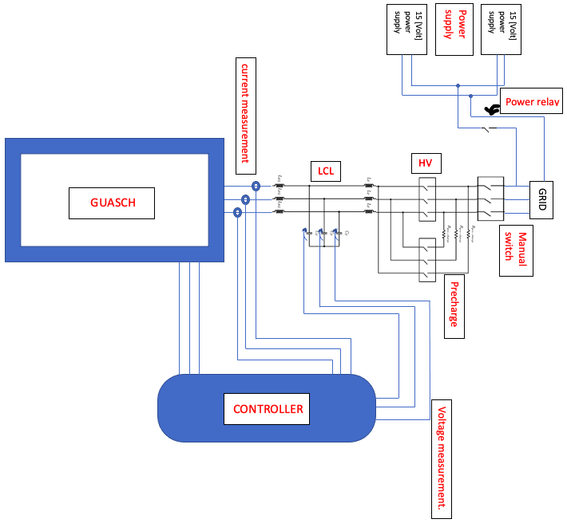

Slide 3
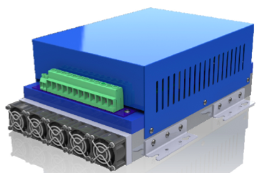
List Of Components:
GUASCH:
Our main component, the inverter.
Using IGBT
CONTROLLER:
circuit control block.
controls and maintains the circuit using PWM
Contains the algorithms.

Slide 4

LCL filter:
Used to get a more clear signal.
Designed and value picked by the other students team in the project.
Sensors:
Voltage and current sensors placed before and on the capacitor in LCL circuit.
Connected to the controller

Slide 5
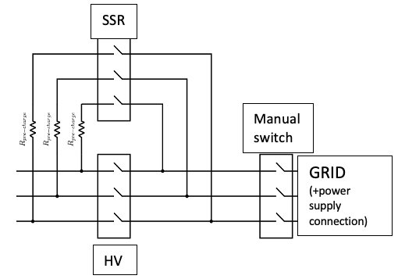
RELAYS: in the circuit we can find relays in 4 places:
Manual (rotary) switch: the grid is connected to the precharge-HV circuit using the manual switch as seen in the circuit diagram. This is our main connector.
Power supply switch: We placed one phase power relay connecting the grid with the 15[V] auxiliariy power supply.
Prechage – HV circuit:
Precharge: we used soft start relay in precharge line, that controls the current going through to the circuit.
HV: in High-Voltage circuit we need circuit breaker which disconnect the circuit in-case of a limit-exceding values of voltage/current.

Slide 6
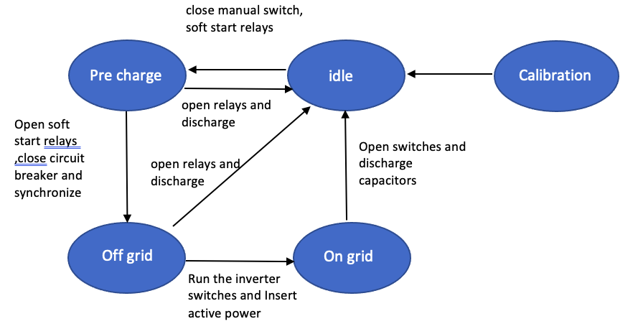
State Machine Diagram

Slide 7
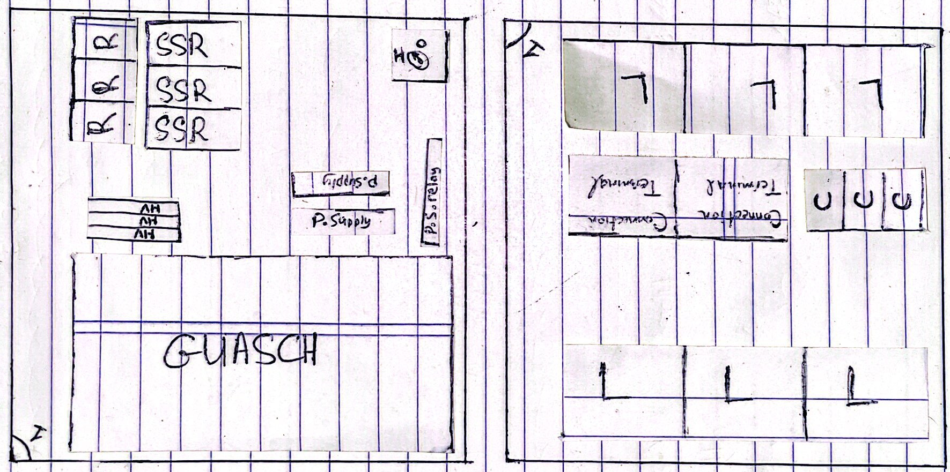

Slide 8
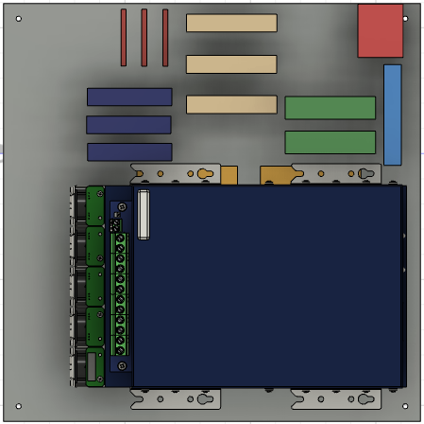
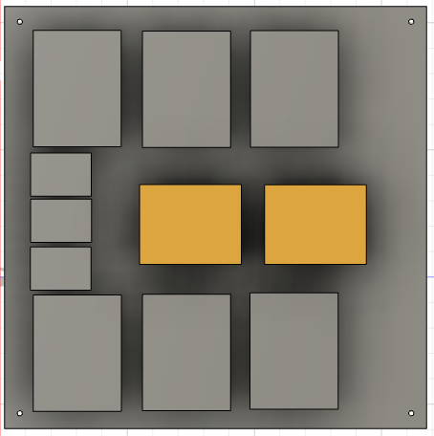

Slide 9
